Slide 1

SWOC ANALYSIS
TRAINING CELL
VIGNAN’S UNIVERSITY

Slide 2
ORIGIN OF SWOT
The origins of the SWOT analysis technique is credited by Albert Humphrey, who led a research project at Stanford University in the 1960s and 1970s using data from many top companies.

Slide 3


Slide 4
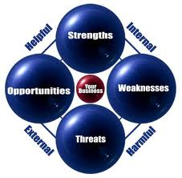
SWOT is an acronym for:
S – Strengths
W – Weaknesses
O – Opportunities
C – Challenges
Internal Environment
External Environment

Slide 5
SWOT ANALYSIS
INTERNAL
POS
I
T
I
VE
NEGATIVE
Build
strength
Overcome
weakness
SWOT
Explore
opportunities
Overcome
Threat
EXTERNAL

Slide 6
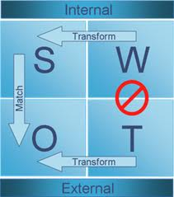
No one can give you better advice than yourself-Ciero
By doing SWOT
Build your strength
Overcome weakness
Explore opportunity
Overcome threat

Slide 7
LIST OF Strengths
Loyal | Willing to learn | Reliable | Hard working
Creative | Responsible | Confident | Trustworthy
Ambitious | Energetic | Friendly | Flexible
Mature | Reliable | Communicative | Independent
Honest | Resourceful | Competent | Analytical
Negotiation | Budgeting | Supervision | Planning
Public Speaking | People skills | Management skills | Technical Skills

Slide 8
List of weaknesses
Aggressive | Recklessness | Lack of Comprehensive ability | Over confidence
Lethargy | Impatient | Lack of confidence | Poor Reading Skills
Short tempered | Poor listening Skills | Fear complex | Negligence
Laziness | Poor Communication Skills | Lack of concentration | Lack of analytical Skills
Postponement | Poor Presentation Skills | Lack of knowledge | Prejudices

Slide 9
SWOT ANALYSIS WORKSHEET
STRENGTHS What do you do well? What unique resources can you draw on? What do others see as your strengths? | WEAKNESSES What could you improve? What do you have few resources than others? What are others likely to see you as weaknesses?
OPPORTUNITIES What opportunities are open to you? What trends you can take advantage of ? How can you turn your strengths into your opportunities? | CHALLENGES What threats can harm you? What is your competitor doing? What threats do your weaknesses expose you to?

Slide 10
How to do SWOT Analysis?
Step 1
Step 2
Step 3
Analyse Internal & External Environment
Perform SWOT Analysis and Document
Prepare Action Plans
A SWOT analysis is useful only when action plans and strategies are developed from the results

Slide 11
Strategies & Action Plans
S/N | What Strength/weakness | Whom to approach | When to approach | Corrective Step taken | Target
1
2

Slide 12
Good One - A BEAUTIFUL STORY
A little boy went to a telephone booth which was at the cash counter of a store and dialed a number.
The store-owner observed and listened to the conversation:
Boy : "Lady, Can you give me the job of cutting your lawn?
Woman : (at the other end of the phone line) "I already have someone to cut my lawn."
Boy : "Lady, I will cut your lawn for half the price than the person who cuts your lawn now."
Woman : I'm very satisfied with the person who is presently cutting my lawn.
Boy : (with more perseverance) "Lady, I'll even sweep the floor and the stairs of your house for free.
Woman : No, thank you.

Slide 13
With a smile on his face, the little boy replaced the receiver. The store-owner, who was listening to all this, walked over to the boy.
Store Owner : "Son... I like your attitude; I like that positive spirit and would like to offer you a job."
Boy : "No thanks,
Store Owner : But you were really pleading for one.
Boy : No Sir, I was just checking my performance at the job I already have. I am the one who is working for that lady I was talking to!"
This is called
"Self Appraisal“
The difference between dream and aim,
Dream requires Soundless sleep to see
Whereas Aim Requires Sleepless Efforts to Achieve..........

Slide 14
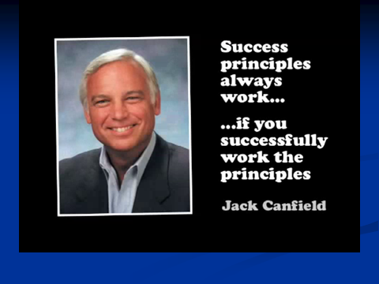

Slide 15
CAT AND FISH-Transform weakness to strength

